Slide 1
Numerical Analysis
False Position Method
Lab7

Slide 2
Functions used in False Position
Write a program to approximate root of equation f(x)=0 in the interval a,b using false position method
Input
- f is the function
- a and b are the left and right endpoints
- delta is the tolerance for the zero
- epsilon is the tolerance for the value of f at the zero (root)
- max1 is the maximum number of iterations
Output
- c is the zero
- yc=f(c)
- err is the error estimate for c

Slide 3
False Position
False position function prototype
function [c,err,yc]=regula(f,a,b,delta,epsilon,max1)
Formula to calculate the value of C
C= (a*f(b)-b*f(a))/(f(b)-f(a))
Condition with dalta
abs(min((b-c),(a-c)))<delta
Condition with epsilon
(abs(yc)<epsilon)
Formula to calculate the error
abs(min((b-c),(a-c)))

Slide 4
Example 1
Define a function in cosmx.m file
  function y=cosmx(x)
  y=cos(x)-x;
Draw the graph of f(x)=cos(x)-x in command window.
>> fplot(‘cosmx', [-pi pi])
>>grid on
The root is lying in the interval [0 1]

Slide 5
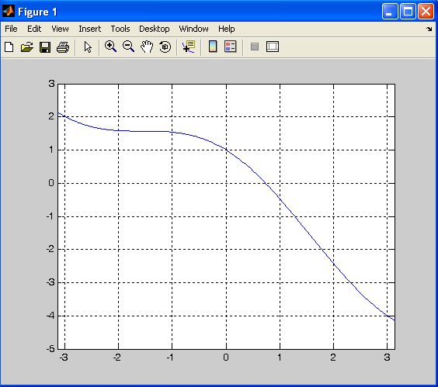

Slide 6
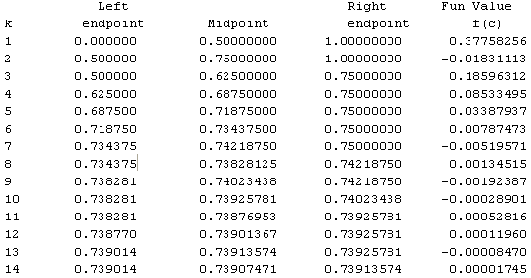
Example 1 using Bisection
>> [k, c,err,yc]=bisect('cosmx',0,1,1e-4)
k = 14
c = 0.7391
err = 6.1035e-005
yc = -3.3625e-005

Slide 7
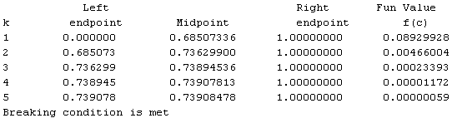
Example 1 using False Position
>> [k,c,err,yc]=regula('cosmx',0,1,1e-4,1e-4,50)
k = 5
c = 0.7391
err = 6.6516e-006
yc = 5.8705e-007

Slide 8
Example 2
Define a function
  function y=xsinm1(x)
  y=(x*sin(x))-1;
Draw the graph of f(x)=cos(x)-x in command window.
>> fplot(‘xsinm1', [0 2])
>>grid on
The root is lying in the interval[1 1.2]

Slide 9
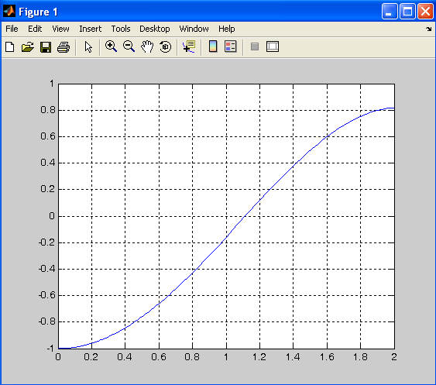

Slide 10
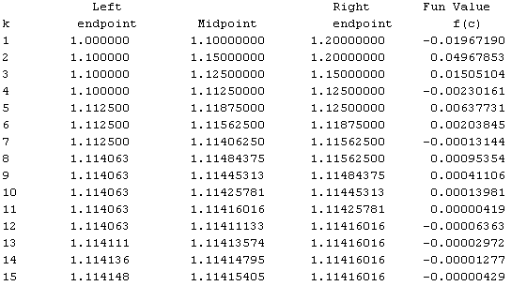
Example 2 using Bisection
>> [k,c,err,yc]=bisect(‘xsinm1',1,1.2,1e-5)
k = 15
c = 1.1142
err = 6.1035e-006
yc = -5.0525e-008

Slide 11
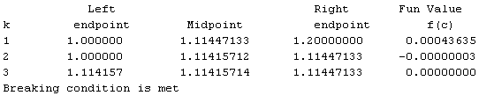
Example 2 using False Position
>> [k,c,err,yc]=regula('xsinm1',1,1.2,1e-5,1e-5,50)
k = 3
c = 1.1142
err = 2.2470e-008
yc = 4.1789e-013

Slide 12
Practice Questions
Analyze the result of bisection and false position methods in example 2 when we change the interval [0 2]
Apply the false position and bisection methods and analyze
  2x³-2.5x-5=0 for the root in the interval [1,2]
  (x-2)²-ln(x)=0 for the root in the interval [1,2] accurate to within 10⁻⁴
  5sin²(x)x-8cos⁵(x)=0 for the root in the interval [0.5,1.5]

Slide 13
Practice Questions
Use the false position method to compute C₀,C₁,C₂ and C₃.
1. exp(x)-2-x=0 [-2.4, -1.6]
2. cos(x)+1-x=0 [0.8, 1.6]
3. ln(x)-5+x=0 [3.2, 4.0]
4. x²-10x+23=0 [6.0, 6.8]

